Slide 1
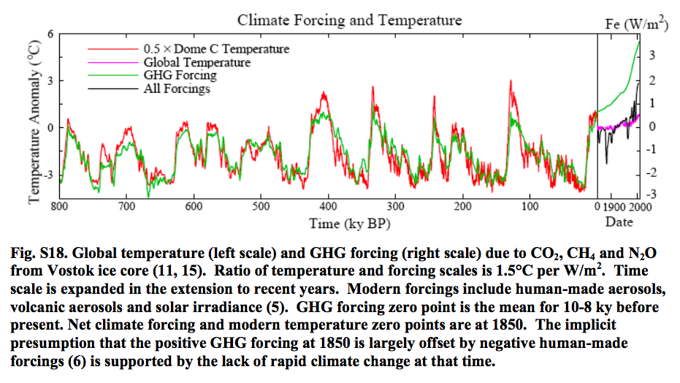
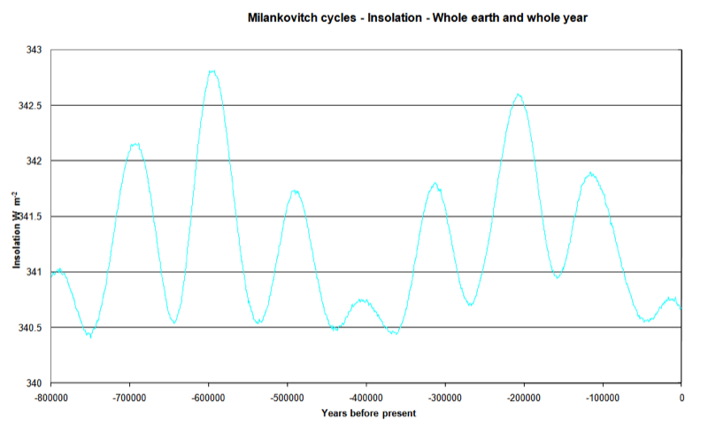
Anthropogenic signaling is probably stronger than Milankovitch signaling
ossfoundation.us/projects/environment/global-warming/myths/images/natural-cycle/Forcing-Temp_1.9wm2.png
Temperature and GHG forcing over the past 800,000 years
3 W/m²
343
Driving force: Orbital wobbling (“Milankovitch Cycles”)
1.5 W/m²
342
Total solar input
341
340
www.climatedata.info/forcing/milankovitch-cycles/

